Slide 1
Risk assessment and Covid-19
Janet
Newsham
Janet@gmhazards.org.uk / 07734 317 158

Slide 2
1. What I am going to cover
Health and Safety Law Overview
Overview of Risk Assessments
Specific issues on Covid-19
Other Relevant issues:
HSE / LA contacts and the state of enforcement
Building confidence/ building resistance
Sharing good practice and solutions
https://www.gov.uk/government/publications/coronavirus-covid-19-implementing-protective-measures-in-education-and-childcare-settings/coronavirus-covid-19-implementing-protective-measures-in-education-and-childcare-settings
Notes:
Welcome to this short overview of Risk Assessments and Covid-19
If anyone has any further questions or issues at the end then please email me and I will get back to you
Apologies if you know this already but we are going to cover an overview of health and safety law – importance of RA
An overview of how RA are formed
Finally we will look at some other relevant issues

Slide 3
2. Health and Safety Law Overview
Principles of Prevention Reg 4 and Schedule 1 of MHSW
Safety reps and Safety Committees Regulations 1977
Notes:
Law not Changed despite the Government Guidance
The HASWA is the enabling act – it is written in general terms and provides a framework for the enactment of Regulations which provide the detailed requirements. There are absolute (clear and specific- obeyed to the letter) and qualified duties (less clear and open to argument – practicable duties where employers have to comply if technical means exist and reasonably practicable duties where a judgement has to be made about the risks and the time,money and effort needed to control them).
Section 2 places a general duty on employers to ensure the safety, health and welfare of their employees: to consult with them concerning arrangements for joint action on health and safety matters…..establish safety committees…..
Section 4 not endanger people using their place of work
Section 9 employer cannot charge employees for anything done or equipment provided for health and safety purposes
Section 7 places duty on employees to take reasonable care to ensure that they do not endanger themselves or anyone else who may be affected by their work activities; and to cooperate with the employer and others in meeting statutory requirements.
The law stresses that management must organise for health and safety and proved the people and resources that will make workplaces safe.
The Management of Health and Safety at Work Regulations 1999 sets out what employers are required to do, in order to comply with their general duties under HASWA.
The absolute duty to undertake suitable and sufficient risk assessments underpins the whole framework of health and safety management.
There are other regulations that contain RA’s and may apply depending on the workplace and work activities but the principles contained in the MHSWR generally apply.
SRSC Regulations
Safety reps have been given a number of statutory functions under the SRSC regs:
Investigate potential hazards, dangerous occurrences, causes of accidents and occupational ill-health, complaints from their members
Carry out inspections (4 x a year)
Employers are required to give information to safety reps and to consult with safety reps with regard to the introduction of any measure which may substantially affect the health and safety of the employees
Employers have no option but to use risk assessments as the primary tool for identifying and controlling hazards and risks in the workplace and safety reps should be involved in the process of risk assessment from the start.
The SRSC regs are sometimes referred to as the ‘brown book’. TU safety reps must be involved in the process and can: monitor that assessments are thorough and carried out by a ‘competent’ person, they contribute their knowledge and expertise, make sure everyone is involved, ensure all hazards are identified and risk evaluated, ensure control measures are appropriate to protect workers and others from the Covid-19, ensure that information is shared to everyone who needs to know and that the risk assessments(RA) are complied with and reviewed and updated as often as necessary.
GENERAL PRINCIPLES OF PREVENTION
These require employers to avoid the risk and where that is not possible to evaluate them and as far as possible combat them at source.
(a)avoiding risks;
(b)evaluating the risks which cannot be avoided;
(c)combating the risks at source;
(d)adapting the work to the individual, especially as regards the design of workplaces, the choice of work equipment and the choice of working and production methods, with a view, in particular, to alleviating monotonous work and work at a predetermined work-rate and to reducing their effect on health;
(e)adapting to technical progress;
(f)replacing the dangerous by the non-dangerous or the less dangerous;
(g)developing a coherent overall prevention policy which covers technology, organisation of work, working conditions, social relationships and the influence of factors relating to the working environment;
(h)giving collective protective measures priority over individual protective measures; and
(i)giving appropriate instructions to employees.

Slide 4
3. Overview of Risk Assessments
Absolute duty - Suitable and sufficient risk assessment (MHSWR – Reg 3)
Carried out by a ‘competent’ person (MHSWR – Reg 7)
Employers must establish emergency and ‘serious and imminent danger procedure (MHSWR – Reg 8)
Employees must be told the risks (MHSWR – Reg 10)
Legal duty for workers to work in a safe manner and tell employer if serious and imminent danger (MHSWR – Reg 14)
Specific RA young, women of child-bearing age, new or expectant mothers (Reg 16-19)
Vulnerable people – additional risks BAME, underlying health issues, older workers
https://www.hse.gov.uk/pubns/indg163.pdf
https://www.hse.gov.uk/simple-health-safety/risk/index.htm
https://www.unison.org.uk/get-help/knowledge/health-and-safety/risk-assessment/
https://www.tuc.org.uk/sites/default/files/extras/riskassessment.pdf
‘we expect schools and trusts to work closely with: parents, staff and unions as they normally would’
‘This guide does not supersede any legal obligations relating to health and safety, employment or equalities’
- Planning guide for primary schools
Notes:
Risk Assessments
The Risk Assessment must consider every aspect of work processes where workers or public could be exposed to risk of transmission by air or by droplets on surfaces. Then develop safe systems of work to avoid that risk of exposure using the control hierarchy.
In consultation with Union safety Reps, develop new Covid-19 exposure risk assessments and safe systems of work, relevant policies and procedures to ensure the health and safety of the workforce, the public and others who might be affected by the work activities. All risk assessments reviewed and all work activities assessed and developed.
There are specific terms that you should be familiar with
Absolute duty
Competent person - HSE says A competent person is someone who has sufficient training and experience or knowledge and other qualities that allow them to assist you properly. The level of competence required will depend on the complexity of the situation and the particular help you need.
When getting help, you should give preference to those in your own organisation who have the appropriate level of competence (which can include the employer themselves) before looking for help from outside. You must consult health and safety representatives in good time on the arrangements for competent help.
-
Workers also have duties and can be prosecuted
Additional risks that need considering:
Black, Asian and minority ethic staff
Emerging evidence that is currently being reviewed by Public Health England shows that black, Asian and minority ethnic (BAME) communities are disproportionately affected by COVID-19. This concerning evidence suggests that the impact may also be higher among men and those in the higher age brackets. The reasons for this are not yet fully understood, but the health inequalities present for BAME communities have long been recognised….and must be taken into account in risk assessments. 4 x more likely than white men
Age
There is evidence that COVID-19 has a greater impact in older age groups. Therefore, older staff may be more at risk as a result of increased age and likelihood of long-term conditions. Employers will need to consider this and take into account government advice on vulnerable workers and shielding. All new staff should be encouraged to disclose any medical condition that might compromise their health.
Disability
Disabled staff … likely to manage their disability through the application of reasonable adjustments. Some of these adjustments will be formally agreed and some informally adopted by staff to suit their own circumstances. It is likely the current situation of the COVID-19 pandemic will bring further challenges for disabled people at work.
Some disabled staff members may have a weak immune system, leaving them more vulnerable to getting an infection. There may be issues associated with personal protective equipment (PPE) and those with a mental health condition may feel increased levels of anxiety and stress…
Gender/ Sex
There is some emerging evidence to suggest that COVID-19 may impact more on men than women, so employers may need to review the approach they have taken in relation to risk assessment (and deployment of returners to NHS). In certain jobs young women have been identified as at more risk. Men in all age groups more likely to die from CV19
Pregnancy
Pregnant women at whatever stage of pregnancy are classed as at risk. The Royal College of Obstetricians and Gynaecologists, Royal College of Midwives and Faculty of Occupational Medicine have developed specific guidance for healthcare workers who are pregnant. In addition, staff who are returning from maternity leave should be assessed against government advice.
Religion or belief
The current situation will coincide with religious events, most notably Ramadan, which will require staff to fast. This may have an impact on the ability of individual members of staff to perform their role fully, especially when wearing the highest levels of PPE…
Government advice on vulnerable workers and shielding should be followed and every effort made to encourage all staff to disclose any medical condition that might compromise their health. Individual risk assessments should include need for additional controls, self-isolating and flexible and alternative working arrangements and additional support.

Slide 5
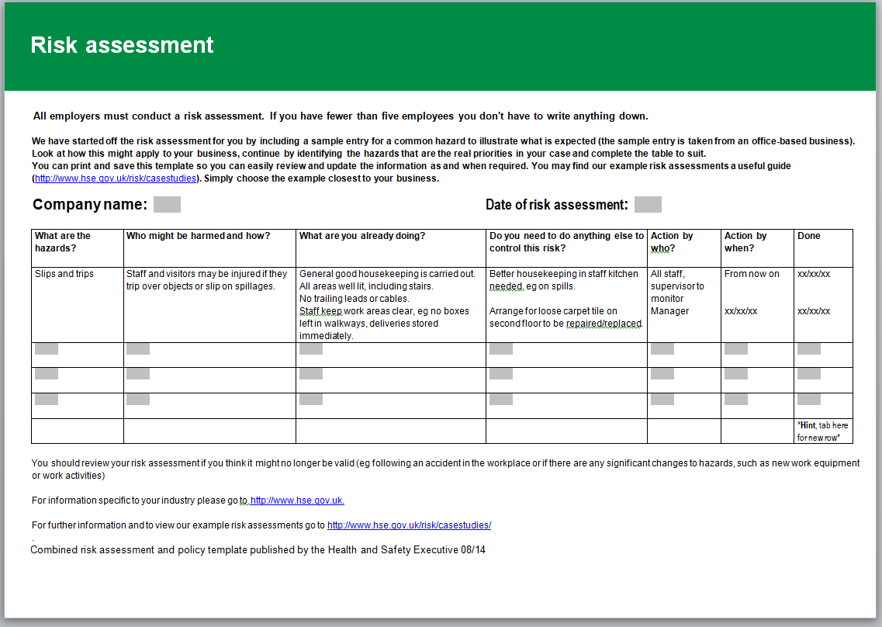
Risk assessment and Covid-19
The Health and Safety Executive's Five steps to risk assessment.
Step 1: Identify the hazards.
Step 2: Decide who might be harmed and how.
Step 3: Evaluate the risks and decide on precautions.
Step 4: Record your findings and implement them.
Step 5: Review your risk assessment and update if. necessary.
Notes:
What is a Risk Assessment?
The legal standard for risk assessment is ‘suitable and sufficient’ this means that all potential hazards have to be identified, the likelihood of harm evaluated and the level of risk estimated and measure to control the risks to ‘as low as is reasonably practicable’. The HSE says that an assessment should be carried out before any work is done that ‘presents a risk of injury or ill health’.
The risk assessment process is not complicated, it is an examination of the work and the workplaces to identify any hazards that could cause harm to people. The HSE, trade unions and the TUC all have examples. Risk assessments identify hazards that could cause both physical or mental harm. It is the employer’s responsibility to carry out the risk assessment.
A hazard is something with the potential to cause harm or injury.
A risk is the likelihood of harm or injury arising from a hazard.
Employers should correctly and accurately identify hazards and potential hazards, determine the likelihood of injury or harm arising, quantify the severity of the consequences and the people who would be affected, take into account any existing control measures, identify any specific legal duty or requirement relating to the hazard, ensure assessments remain valid, provide sufficient information to enable control measures to be determined, prioritise remedial measures and then record the findings.

Slide 6
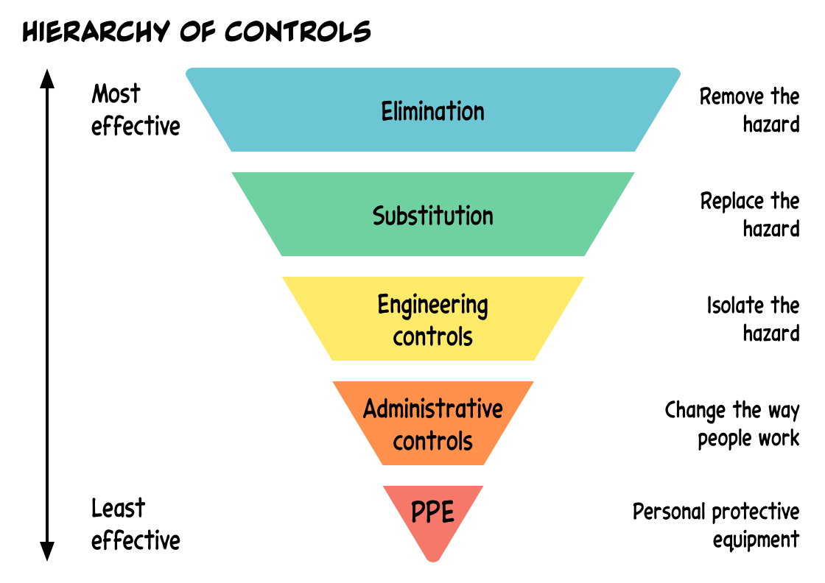
https://www.hseni.gov.uk/news/example-risk-assessment-covid-19-workplaces
Planning Guide for primary schools – NEU/GMB/Unison/Unite Commentary and checklist
Notes:
Example RA is from HSENI
Hierarchy of Control
Employers are required to use the principles of prevention that adopt a hierarchy of control approach which are set out in Schedule 1 to the regulations. This means that first employers should consider how to avoid the risk altogether, if this is not possible then control the risk in the following order:
1.Elimination
2.Substitution
3.Engineering controls
4.Administrative controls
5.PPE
Step by Step Approach to Risk Assessment
This step by step approach to risk assessment of the new risk of Covid-19, must take consideration the health and safety of those involved - managers and safety reps by ensuring social distancing (initially conducting any walk through when no one is about and remote reviews where appropriate).
To identify the hazards:
Walk around the workplace where possible
Map with dimensions, locating equipment
Observe work being done whilst maintaining social distancing
Speak to people doing the activity
Speak to those who maintain and clean the workplace
Think about the risks at different times of the day
Think about risks during different weather / times of year
Think about longer-term health risks
Check manufacturers’ instructions/data sheets/safety systems
Look at accident and ill-health records
Check existing safe systems of work and review
Check ventilation maintenance against expert advice to reduce the spread of Covid-19 – no recirculation of air
Check HSE and industry guidance and best practice
All plant and equipment which have been closed during lock-down must be reviewed for safe operation and to identify new and existing hazards
Record all the hazards identified
For each hazard evaluate the risks and determine the controls by applying the hierarchy of control and using a precautionary approach
Who might be harmed and how:
Employees, visitors/members of the public, contractors, maintenance and servicing staff, childbearing or pregnant women or new mothers, children/young people, workers with disabilities, homeworkers, people sharing the workplace, BAME workers, young workers
How will the information be shared to all those who need to know?
Is specific training needed?
How will you check that the controls are in place and working effectively?
Are people doing what they are supposed to do?
Are the controls doing what you intend them to do?
Are risks being adequately controlled?
Do you need to change anything? – consider all the consequences of any change before implementing it

Slide 7
4. Specific issues on Covid-19
Transmission of the virus:
Transmitted through droplets and contact points, and main approaches to controlling the spread by:
Reducing those exposed –
Isolating workers in contact, vulnerable or ill
Workers working from home
Social/personal distancing,
Supporting and encouraging testing, tracing and isolating
Enhanced hygiene and cleaning
Providing PPE
Consequences of not complying with Public Health Legislation
HSE / LA to enforce
Actions can take form of advice through to issuing enforcement notices
Symptomatic
https://www.npr.org/sections/goatsandsoda/2020/04/13/831883560/can-a-coronavirus-patient-who-isnt-showing-symptoms-infect-others
Social Distancing -
https://www.weforum.org/agenda/2020/04/coronavirus-microdroplets-talking-breathing-spread-covid-19/ https://youtu.be/vBvFkQizTT4
Virus on surfaces –
https://www.nejm.org/doi/full/10.1056/NEJMc2004973?fbclid=IwAR04mB_uI-_6mW8TWqPsuQ4zPw20ol4fjt4r5rfSoBlvDSoWdgpaN8Aj69c
Covid-19 cannot be eradicated and therefore the employer has a legal responsibility to protect workers and others from the risk to their health and safety and it is reasonably practicable to minimise them.
https://www.gov.uk/government/publications/preparing-for-the-wider-opening-of-schools-from-1-june/planning-guide-for-primary-schools
Notes:
Start from a position of reducing the risk by home working, online meetings instead of face to face, and flexible working. Keep people away from potential infection where ever possible. We cannot determine the length of time it will be necessary to take additional precautions, there is no known vaccination and clearly until then the aim is to reduce the spread of the disease. Any controls may have to be in place for months/years, so must be robust. All workers should have available testing to determine whether they are a risk to others, if they have been in contact with someone with the disease. Also there needs to be policies and procedures for workers self-isolating, protecting vulnerable family members, or taking sick leave or carers leave without any absence penalties. Also, all workers must be made aware of their legal rights to refuse work they feel exposes them to danger.
Hold employers to account – if they display the posters keep that declaration on the agenda
Ensure the reps are holding regular reviews of the situation – daily, and weekly at least.
Specific workplaces where lots droplets/compressed air/others

Slide 8
5. Other relevant issues
HSE / LA contacts and the state of enforcement
Building confidence/ building resistance
Sharing good practice and solutions
https://www.tuc.org.uk/sites/default/files/APPG_Local_Authorities_Report_2018_AW.pdf
http://www.hazards.org/votetodie/
https://tuccampaigns.typeform.com/to/Ypm6Pq
Notes:
HSE/LA – under resourced, not enough officers, not enough expertise
Resisting Riddor reporting but important to establish audit trail of record of infections and deaths
Report in accident book near misses / infections / deaths – email/write down and keep copies!
Link to TUC form to register concern at HSE
Evidence to pass to HSE inspector – photographic evidence, where possible
Audit trail of issues raised with employer, mapping of infections/deaths to areas/work activities
TU collective action – Section 44 / 100 Employment Rights Act - raise confidence
Share good practice

Slide 9
Links to more information/help
Further Information:
https://www.unison.org.uk/coronavirus-rights-work/
https://www.unison.org.uk/unison-health-and-safety/coronavirus-guidance-health-safety-reps/
Hazards Campaign How do we approach reviewing the Risk Assessments in the Workplace because of Covid-19 https://gmhazards.org.uk/wp-content/uploads/2020/05/How-do-we-approach-reviewing-the-Risk-Assessments-in-the-Workplace-because-of-Covid.pdf
Brown Book https://www.tuc.org.uk/sites/default/files/BrownBook2015.pdf
GMHC Safety reps short version: http://www.hazardscampaign.org.uk/wpcontent/uploads/2018/08/safetyrepstoolkit.pdf
TUC Risk Assessment: https://www.tuc.org.uk/research-analysis/reports/riskassessment-guide-safety-reps
TUC Preparing for return to work outside the home https://www.tuc.org.uk/researchanalysis/reports/preparing-return-work-outside-home-trade-union-approach
Health and safety legislation in Great Britain is enforced by HSE or one of the over 380 local authorities depending on the main activity carried out at any particular premises. In general LAs are the main enforcing authority for retail, wholesale distribution and warehousing, hotel and catering premises, offices, and the consumer/leisure industries. HSE Contact :https://www.hse.gov.uk/contact/concerns.htm A union rep can report Covid-19 direct to the HSE using email: union.covidconcerns@hse.gov.uk
https://tuccampaigns.typeform.com/to/Ypm6Pq
British Occupational Hygiene Society guidance on how to ensure a safe and healthy environment during the COVID-19 pandemic http://www.bohs.org/return-to-work-guidance/
Simon Hester film: https://www.facebook.com/108223534168406/videos/238630747546976/

